Slide 1
NOSC Tools
The Snowball Project

Slide 2





Snowball Apps
Network Cells Discovery (Multivendor).
Sites and Cells Business Status.
Power Alarms Monitoring
Planned Outage Reporting.
Halting and Activation Automation.
Notes:
Snowball Apps are pluggable applications integrated in one web application to provide real-time data updates and interoperability. Network Cells Discovery : a snapshot from the RAN network is taken on timely basis to update the centralized topology reference database with the below :
1- Defined Cells and sites.
2- Rehoming and swapping actions and Controller (BSC/RNC) update.
3- The cells status (Locked / Active).
The discovery module shares the results with the Business Status Application which is developed to enrich the sites and cells data with the complementary information to facilitate the below:
1-Site Status Reporting.
2- Full/ partial site outage logging based on the business status (ON AIR, DISMATLED, HALTED … ).
3- Network cells status auditing to detect the system vs. business status discrepancies.
4- Cells supervision definition auditing.
5-Referencing Business KPIs calculations and Business Status exclusions.
6- Battery Backup Time Calculations.
Power Alarms Monitoring is based on an alarms analyzer to detect alarms toggling, automatically follow an escalation process for the power alarms on VVIP, HUB and SUB-HUB Sites and only ceases escalation after a cool-down period to ensure that the problem is solved.
The module is developed with a level of abstraction to allow further customization and coverage to alarms related to other problems such as Outages and Doors.
Planned Outage Reporting: it is developed to flag the site and cell outage records in our Automated Outage System if they are related to a planned action in near real time.
It also notifies the FO dispatchers by commenting the alarms related to the planned actions and their violation status (OK/ VIOLATED) with a distinguishing comment (1111-PLANNED- [CR ID] – [violation-Status]).
The Halting and activation application is designed to trigger halting and activation commands to the OSS along with an event podcasted to alert different modules like the power alarms monitoring so it keep record of the site and check the active power alarms on timely manner.

Slide 3
What is it about?
It is about integrating all in-house developed applications into one inter-connected applications bundle that feed each other with near-real time updates.
Adopting a dynamic event based model being continually updated with network readings from reliable data sources.
Co-relating the operations standard operations execution processes to produce accurate high level overview of network operations and statistics as well as detailed insight of network operations.
Taking advantage of modern web technologies to develop satisfactory user experience to the network operations engineers and managers.

Slide 4
Methodology
Small steps, big added value.
Data Correlation.
Continues integration.
Modular Components.
Multivendor support.

Slide 5
Outcome
Enhance the WoW and Reporting quality.
Real time data collaboration and correlated tasks output.
Centralize network topology enrichment info to serve multiple reports to maintain high data integrity.
Open horizon to endless possibilities of operations automation.

Slide 6
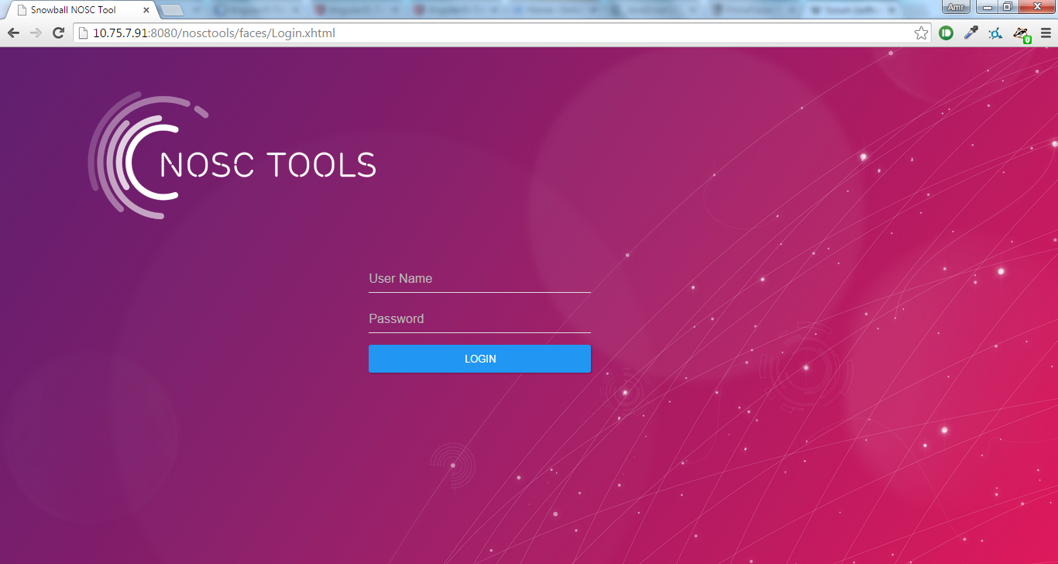
Screenshots

Slide 7
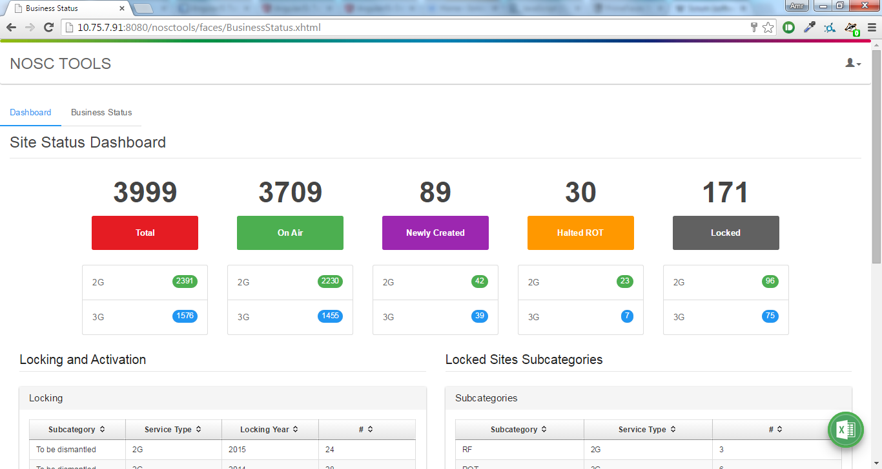
Screenshots

Slide 8
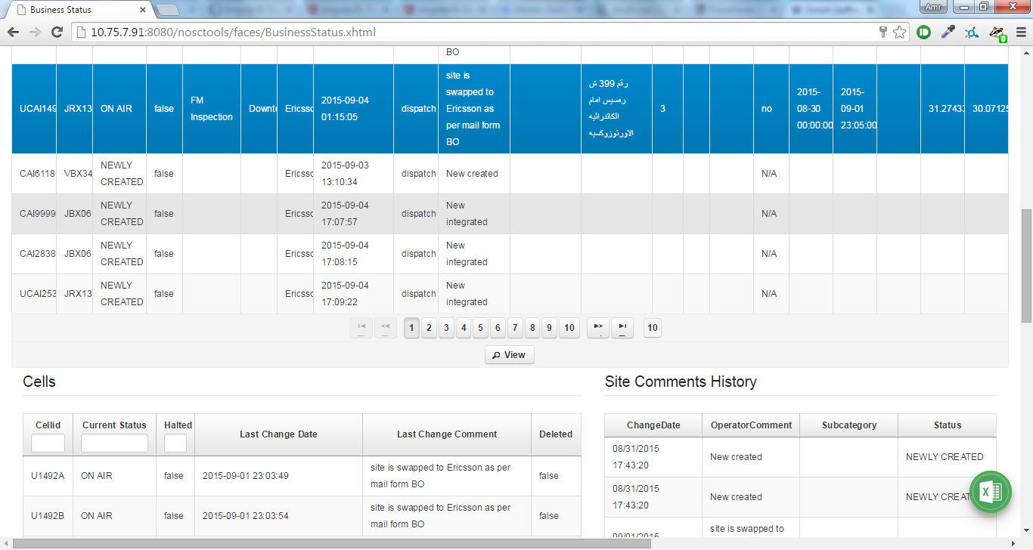
Screenshots

Slide 9
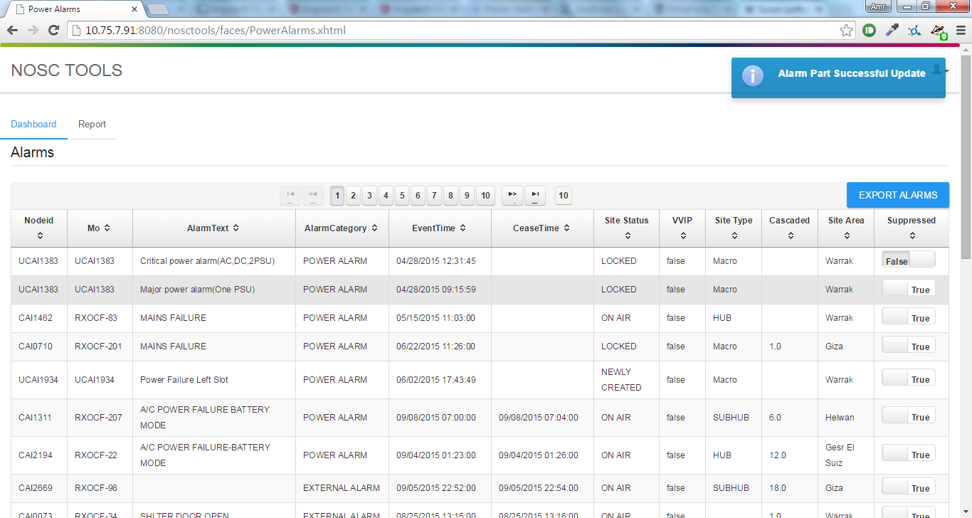
Screenshots

